Slide 1
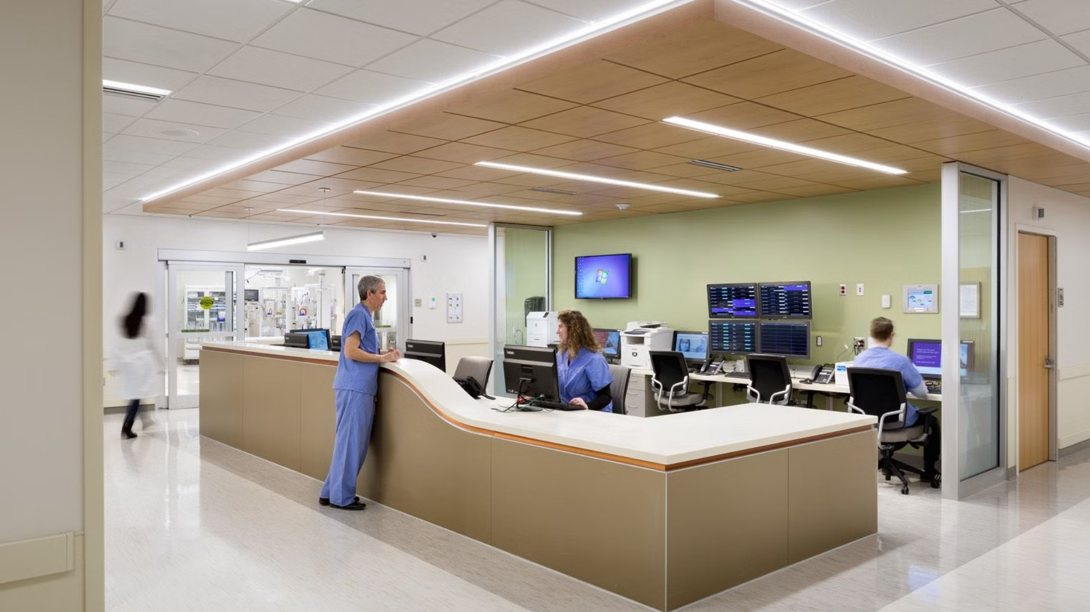
Medical Management System
C++ & SQLite-Based Database Management System.

Slide 2

Introduction
Centralized Patient Records: Securely stores medical history, appointments, and test results in one place for fast access and better care coordination.
Accurate & Reliable Data: Maintains data integrity with robust validation and error handling, supporting informed clinical decisions.
Strong Security & Compliance: Safeguards data with encryption, access controls, and HIPAA compliance to prevent unauthorized access and breaches.

Slide 3

Key Features
Efficient Data Storage: SQLite provides fast, serverless storage for quick access to patient records, enabling timely clinical decisions.
Comprehensive Patient Profiles: Stores medical history, contact, insurance, and emergency details for personalized, informed care.
Doctor Management: Tracks doctor specializations, schedules, and credentials to streamline scheduling and collaboration.
Data Persistence & Backup: Ensures continuous access with reliable storage, backups, and redundancy to prevent data loss.

Slide 4
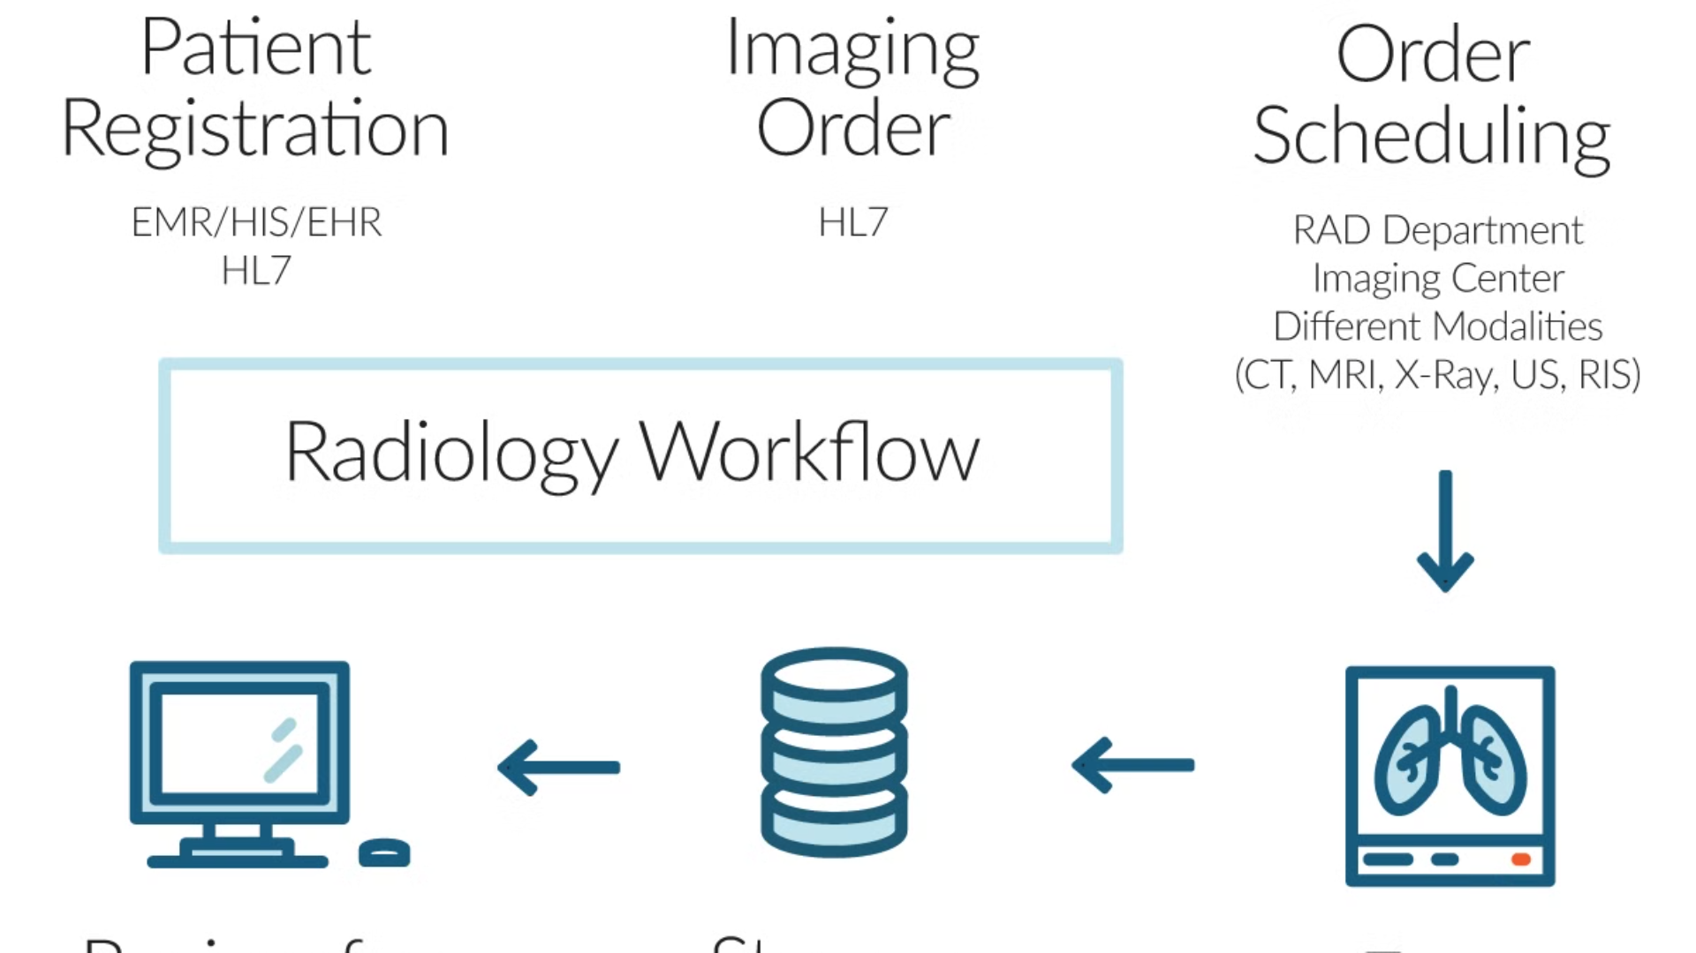
System Workflow
Database Initialization: Opens or creates medical_system.db using SQLite for storing medical data.
Table Creation: Creates Patients and Doctors tables (if not existing) with relevant fields like name, age, gender, department, and salary.
Patient Data Entry: Takes user input for patient details and securely inserts them into the Patients table using prepared statements.
Doctor Data Entry: Takes user input for doctor details and inserts them into the Doctors table with proper binding and execution.
Data Persistence: Finalizes statements, ensures data is saved, and closes the database, ensuring integrity and availability.

Slide 5

Conclusion
Efficient: Organizes medical records efficiently, ensuring quick access to patient histories and streamlined workflows for healthcare professionals. This efficiency leads to better patient care by allowing doctors and nurses to quickly review a patient's medical background, understand their current conditions, and make informed decisions.
Future: Enhance with a GUI for user-friendly interaction, offering intuitive navigation and real-time data visualization. A well-designed GUI would provide a seamless and interactive experience for users, making it easier to input, access, and analyze patient data.
Scalable: Adaptable solution suitable for small clinics to large hospitals, accommodating growing data needs and user demands with seamless integration of new features and modules. This scalability ensures long-term usability and relevance as healthcare organizations evolve and expand.

